Slide 1

Block coding Developer
Session - 37
HTML Headings & Paragraphs

Slide 2

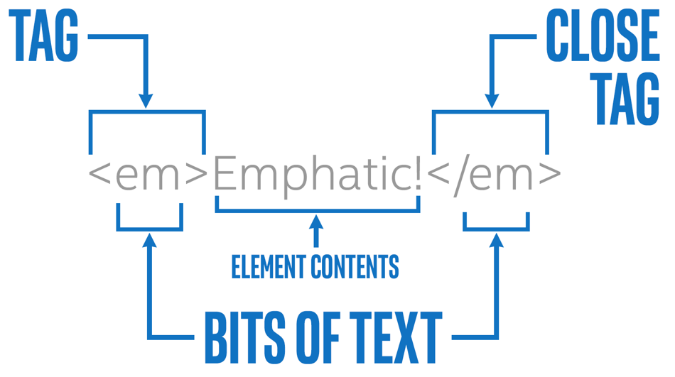
Recall…
What we have learnt in last session
What challenges you are facing

Slide 3
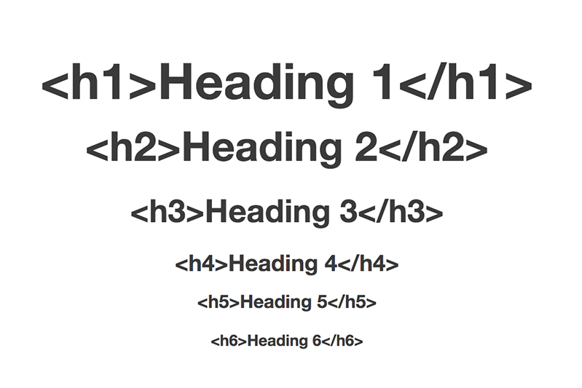
Headings & Paragraphs…
We will Learn today:
What is an HEADINGS in HTML
What are PARAGRAPHS in HTML
What we can do with HEADINGS & PARAGRAPHS

Slide 4
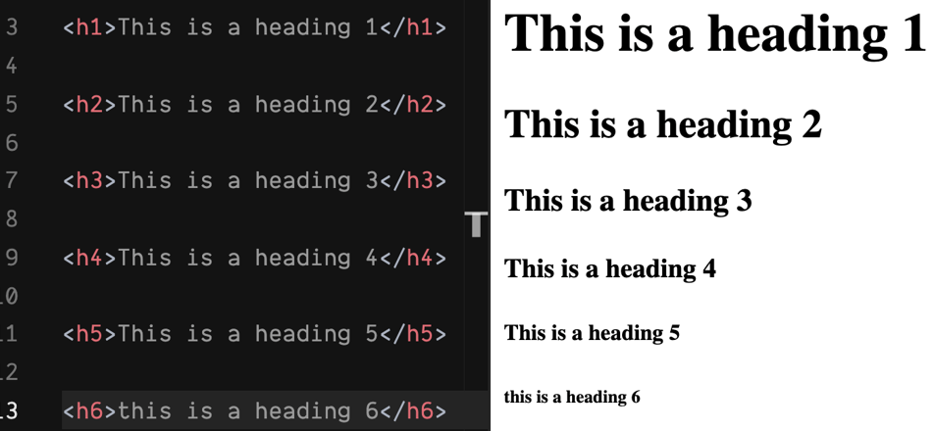
What is Heading?
HTML defines six levels of headings
The heading elements are H1, H2, H3, H4, H5, and H6 with H1 being the highest level and H6 the least
HTML heading are defined with the <h1> to <h6> tags
Note: Browsers automatically add some white space (a margin) before and after a heading.

Slide 5
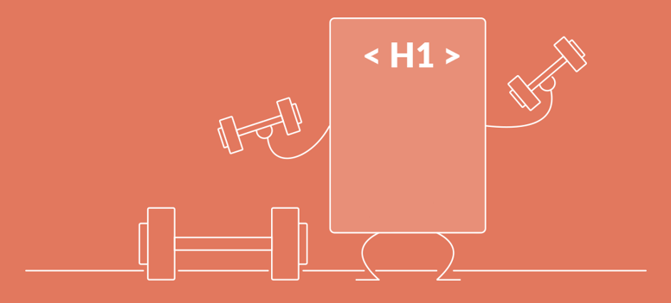
Headings Are Important…
Search engines use the headings to index the structure and content of your web pages
Users often skim a page by its headings
<h1>headings should be used for main headings, followed by <h2> headings, then the less important<h3> and so on…
Note: Use HTML headings for headings only. Don't use headings to make text BIG or bold.

Slide 6
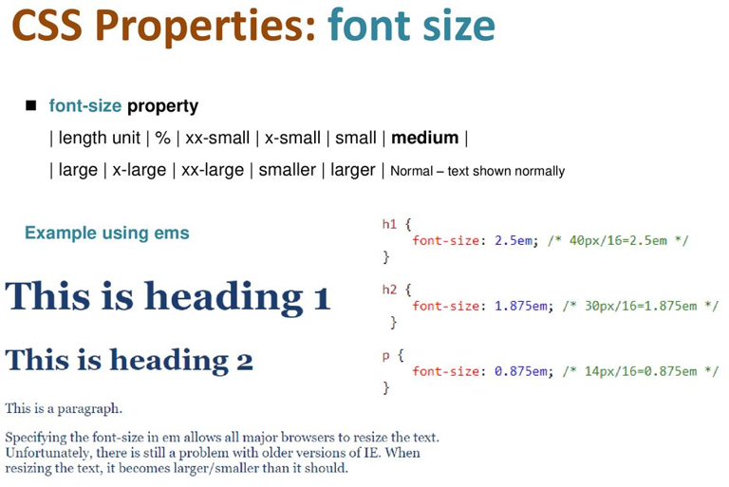
Bigger Headings…
Each HTML heading has a default size
However, you can specify the size for any heading with the style attribute, using the CSS font-size property

Slide 7
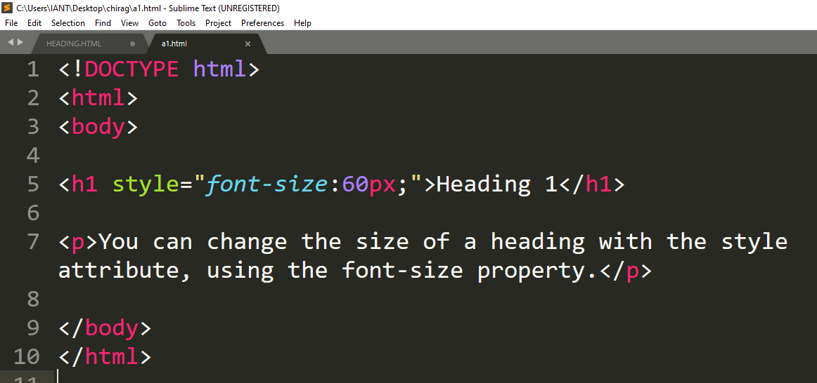
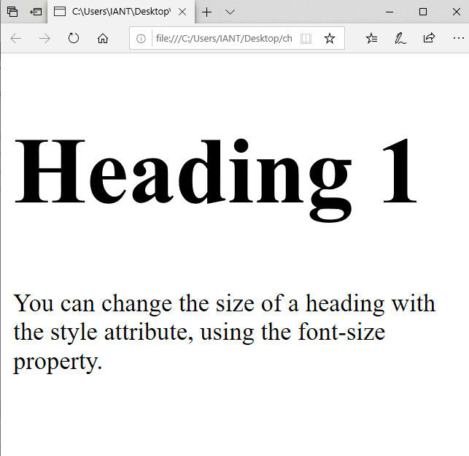
Example - Headings…

Slide 8
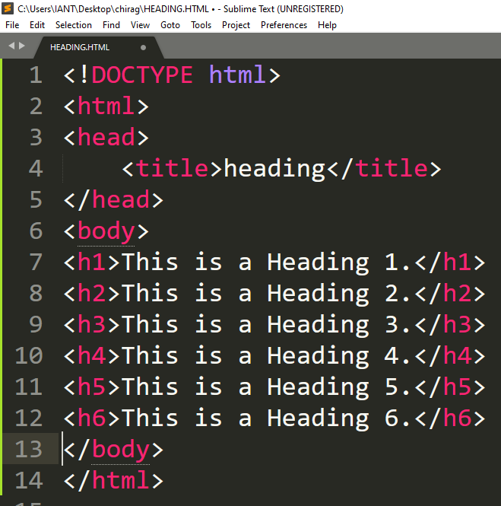
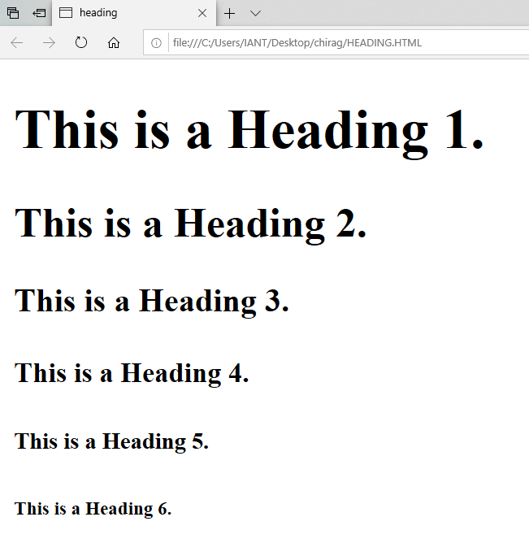
Example - Headings…

Slide 9
Importance of Heading…
Note: Each time you place a heading tag on a web page, the web browser built-in style sheets automatically create some empty space (called margin) before and after each heading
You can use the CSS margin property to override the browser's default style sheet
HTML headings provide valuable information by highlighting important topics and the structure of the document, so optimize them carefully to improve user engagement
Don't use headings to make your text look BIG or bold. Use them only for highlighting the heading of your document and to show the document structure

Slide 10
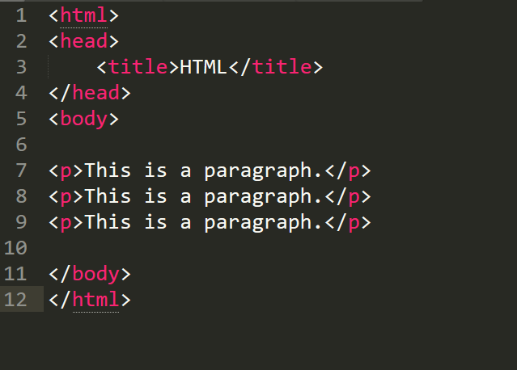
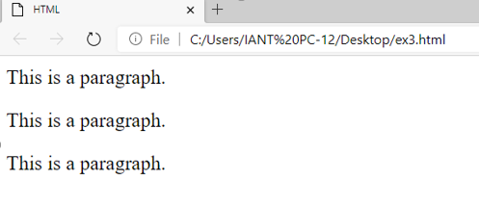
What is Paragraph?
The HTML <p> element represents a paragraph
Browsers automatically add a single blank line before and after each <p> element
A paragraph always starts on a new line, and is usually a block of text

Slide 11
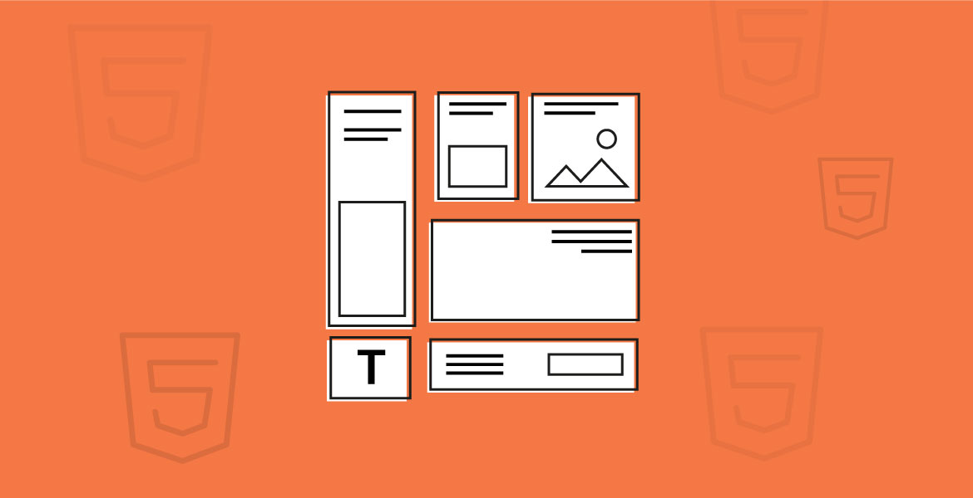
HTML Display…
You cannot be sure how HTML will be displayed
Large or small screens, and resized windows will create different results
With HTML, you cannot change the display by adding extra spaces or extra lines in your HTML code
The browser will automatically remove any extra spaces and lines when the page is displayed

Slide 12
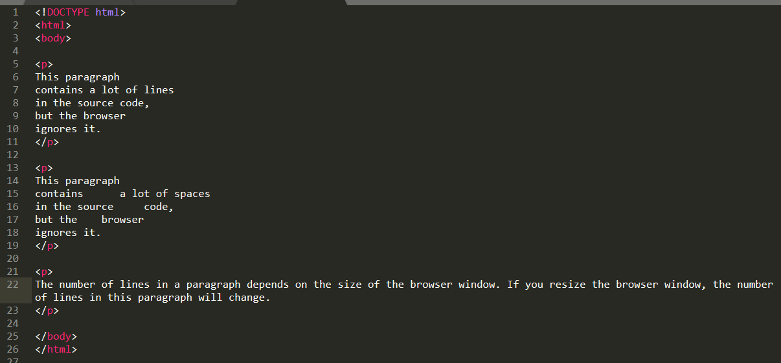
Example – HTML Display…

Slide 13
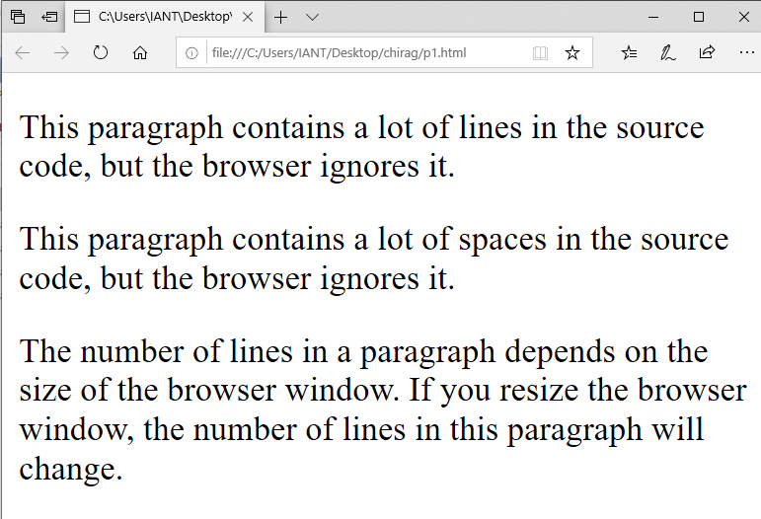
Output-1
Example – HTML Display Output…
Output-2

Slide 14
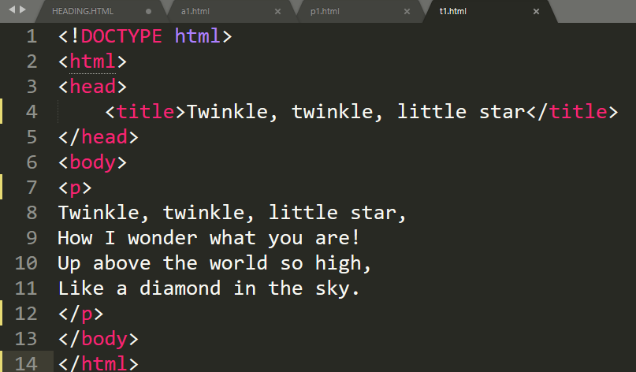
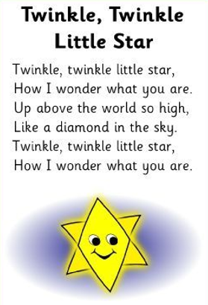
The Poem Problem…

Slide 15
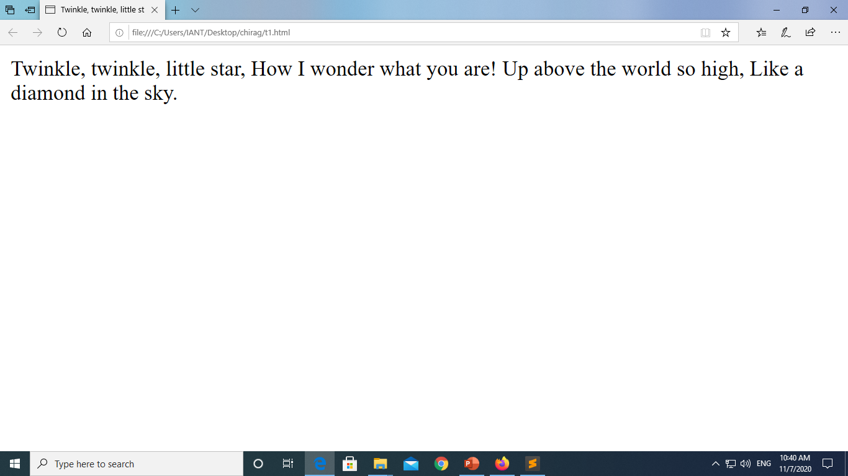
Output…

Slide 16
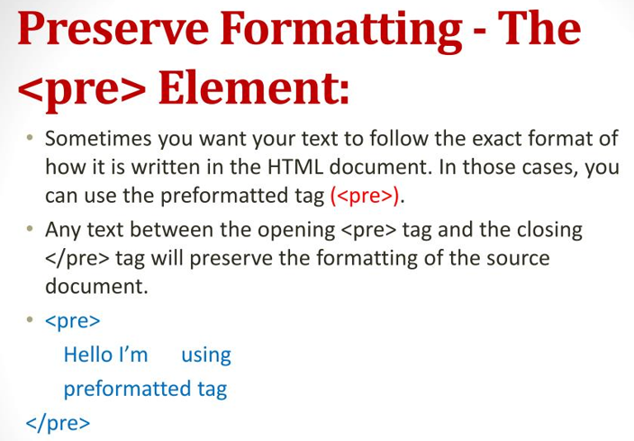
The <pre> Element…
Preserve Formatting, the HTML <pre> element defines preformatted text
The text inside a <pre> element is displayed in a fixed-width font (usually Courier), and it preserves both spaces and line breaks

Slide 17

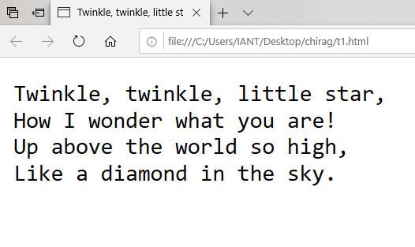
Example – Pre Element…

Slide 18
Specific Attributes…
The HTML <p> tag also supports the following additional attributes
Attribute | Value | Description
align | left right center justify | Specifies text alignment within a paragraph.

Slide 19
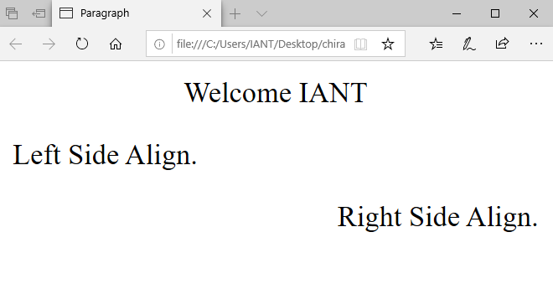
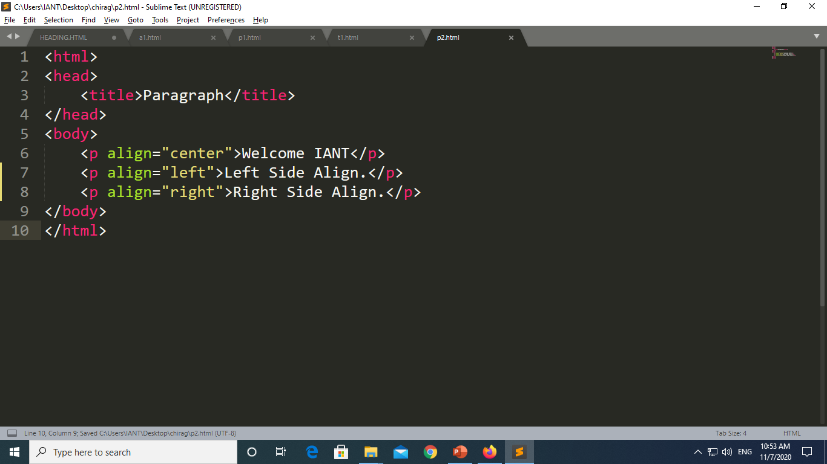
Example – Specific Attributes…

Slide 20

Summary…
Headings In HTML
Paragraphs In HTML
What we can do with Headings & Paragraphs

Slide 21
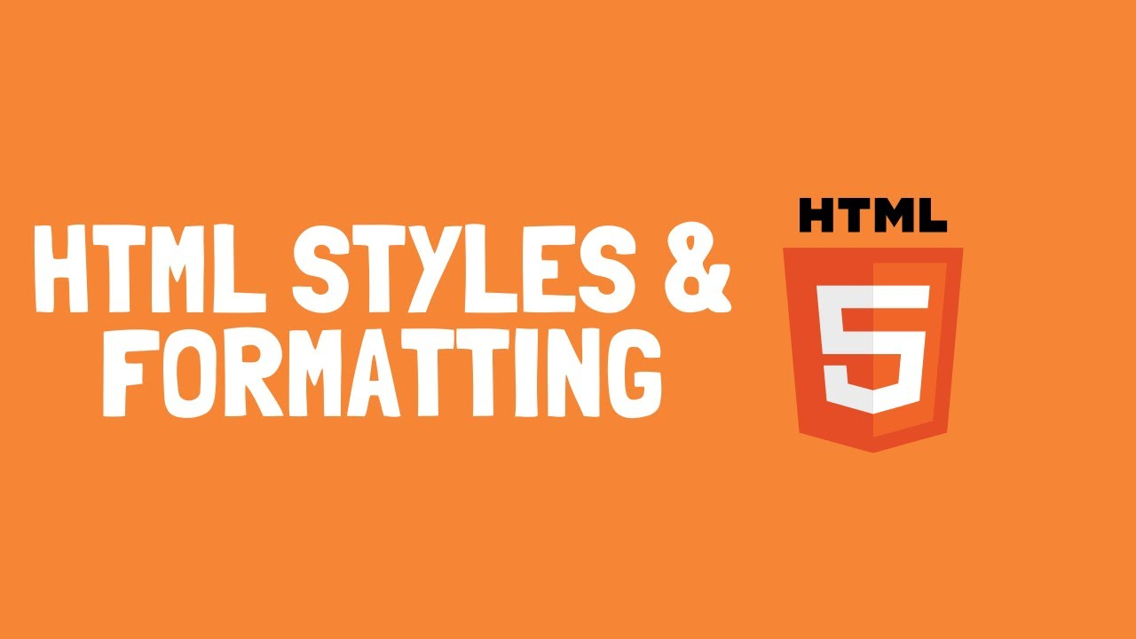
Next Session…
Style and formatting.
Background Colour in HTML
Text Colour in HTML
Font Family in HTML
Text Size in HTML
Text Alignment in HTML

